Slide 1
Visualisasi Workhsop PL
Umi Sa’adah

Slide 2
Design Sprint
Ada dua jenis Design Sprint -> dua jenis masalah bersama
Product Enhancement : (bisa berbagai macam)
Product Validation : “Ide produk apa yang peluang suksesnya paling besar?”

Slide 3
Design Sprint
Day 1 : Understanding
User interview
Competitive review
Day 2 : Diverging
Day 3 : Deciding
Day 4 : Prototyping
Day 5 : Validating

Slide 4
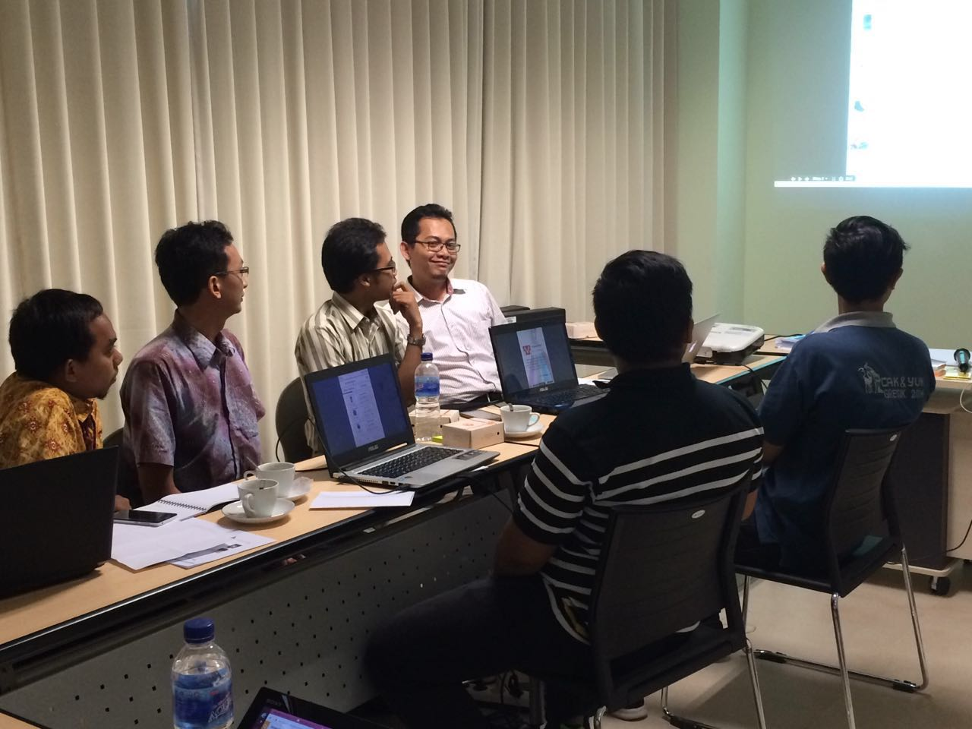
Day 1 : UNDERSTANDING (user interview)

Slide 5
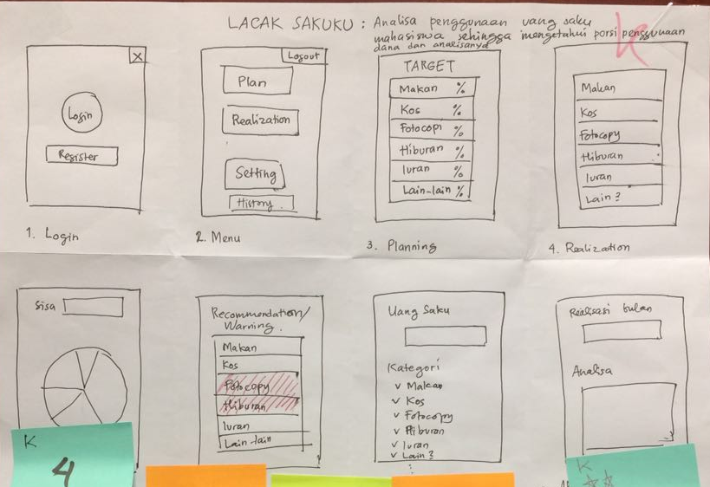
Day 2 : DIVERGING

Slide 6
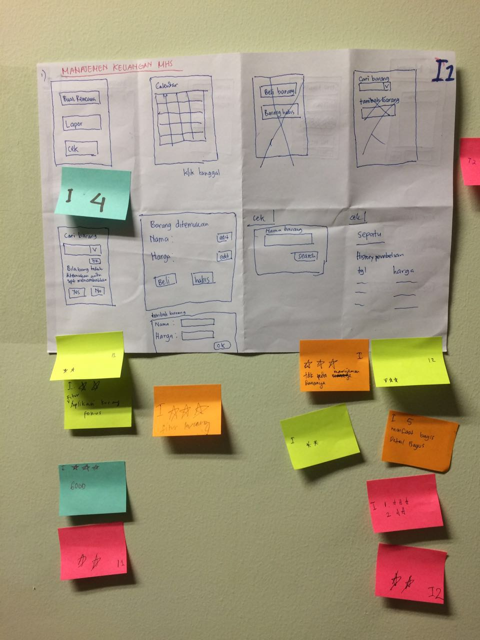
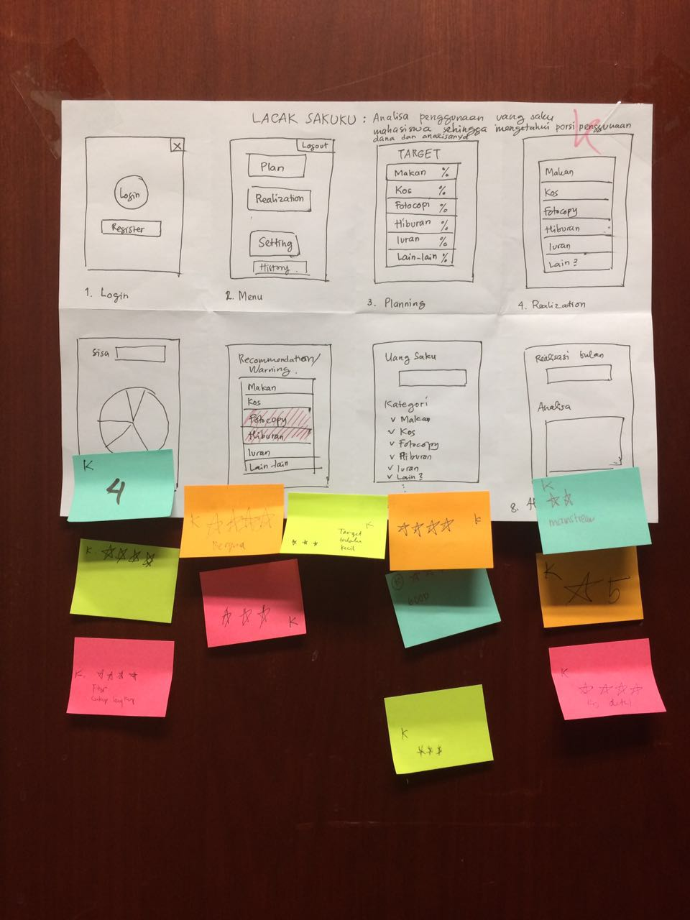
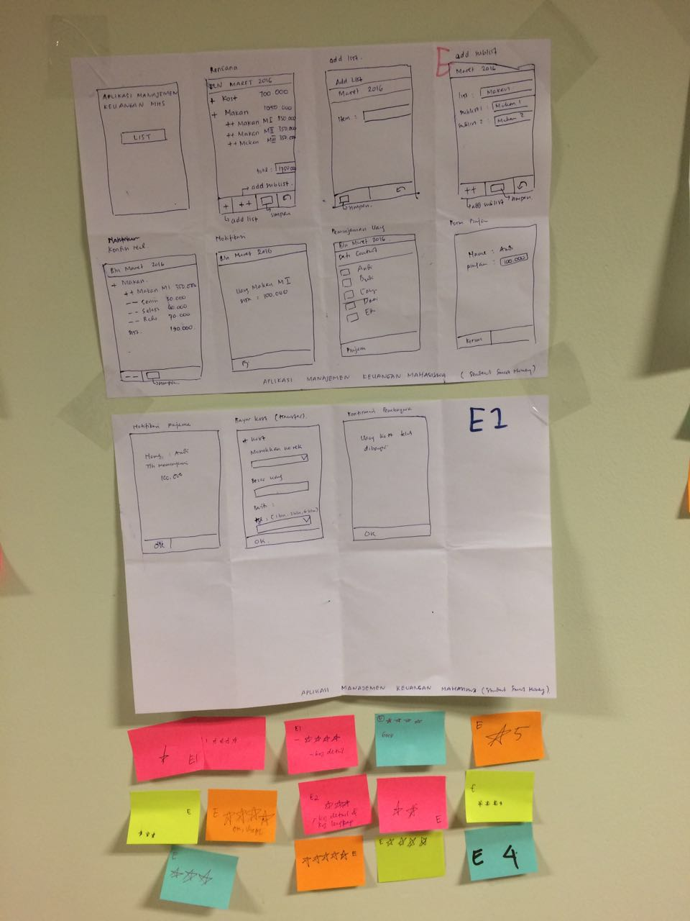
Day 3 : DECIDING

Slide 7
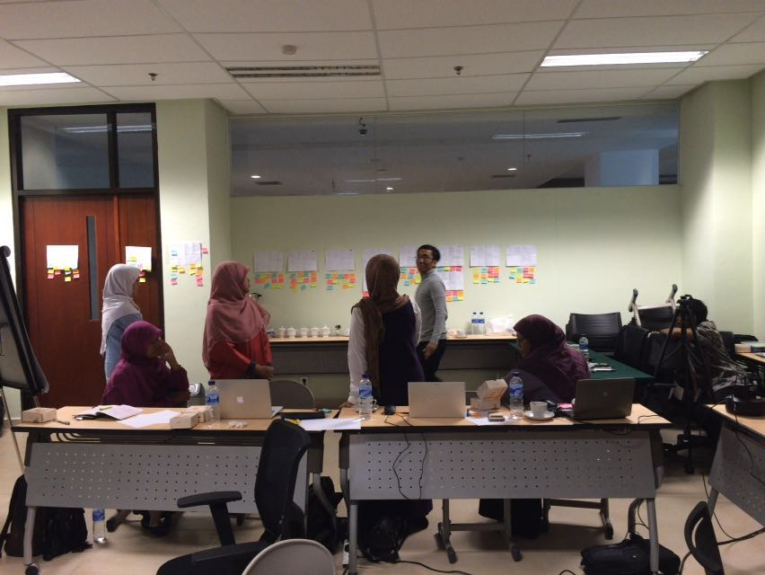
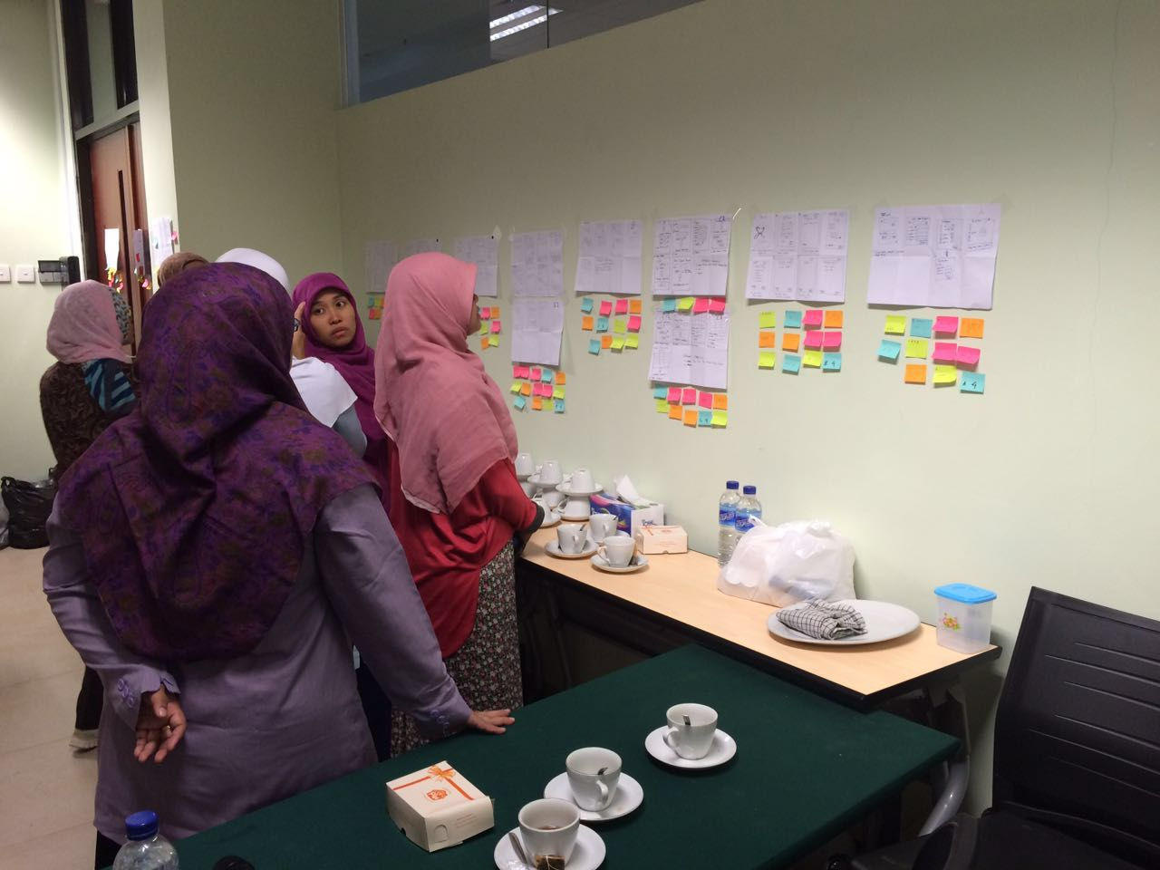
Day 3 : DECIDING (cont)

Slide 8
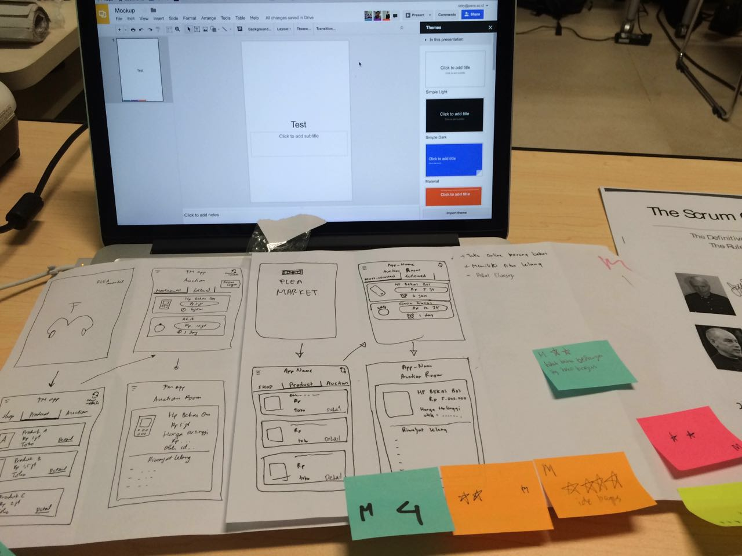
Day 4 : PROTOTYPING

Slide 9
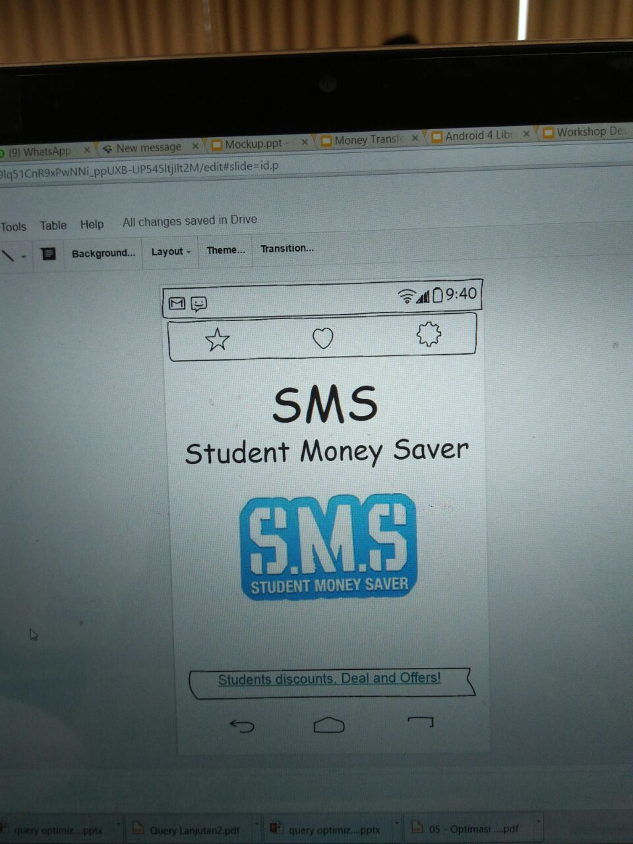
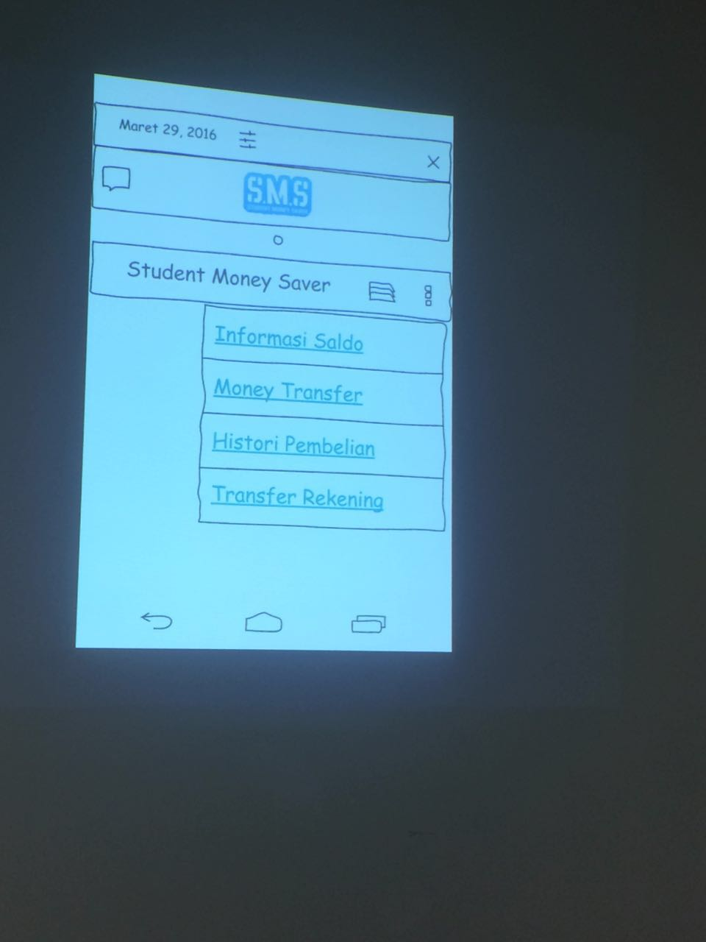
Day 4 : PROTOTYPING (cont)

Slide 10
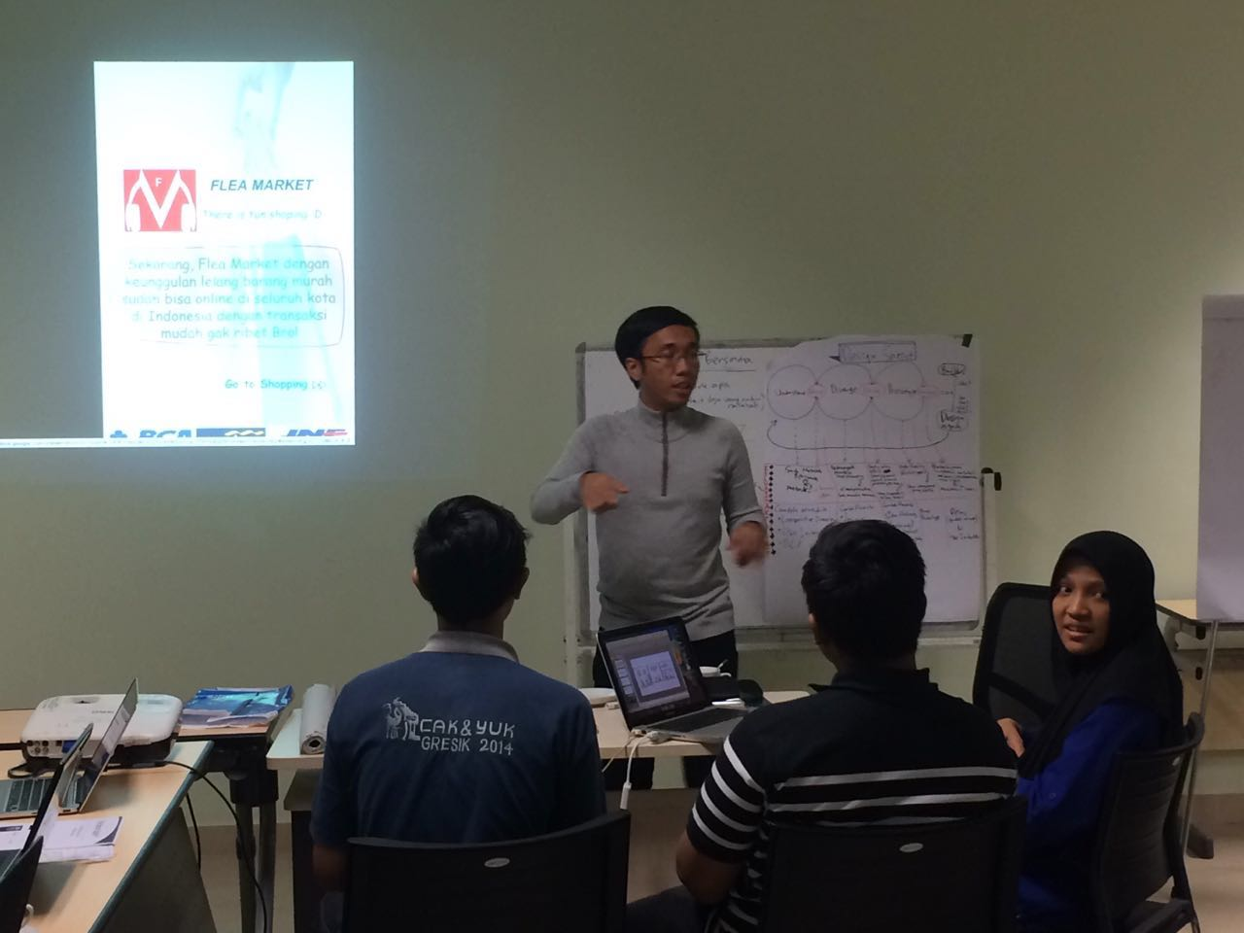
Day 5 : VALIDATING

Slide 11
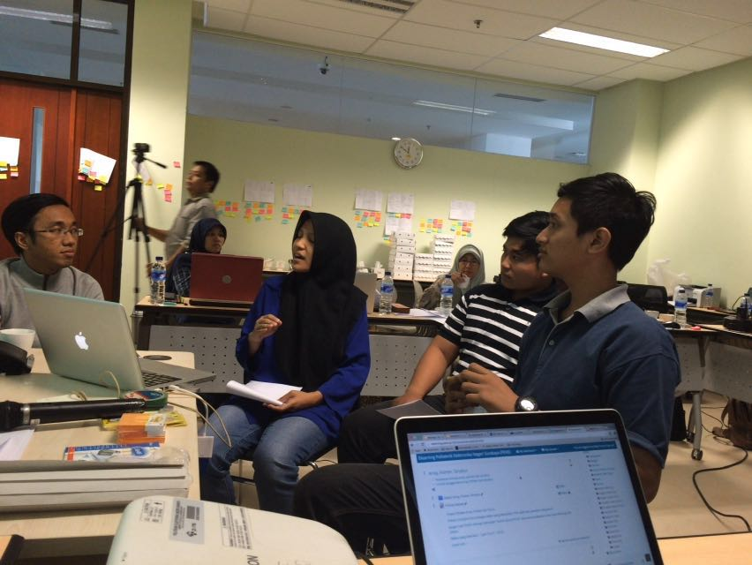
Day 5 : VALIDATING (cont)

Slide 12
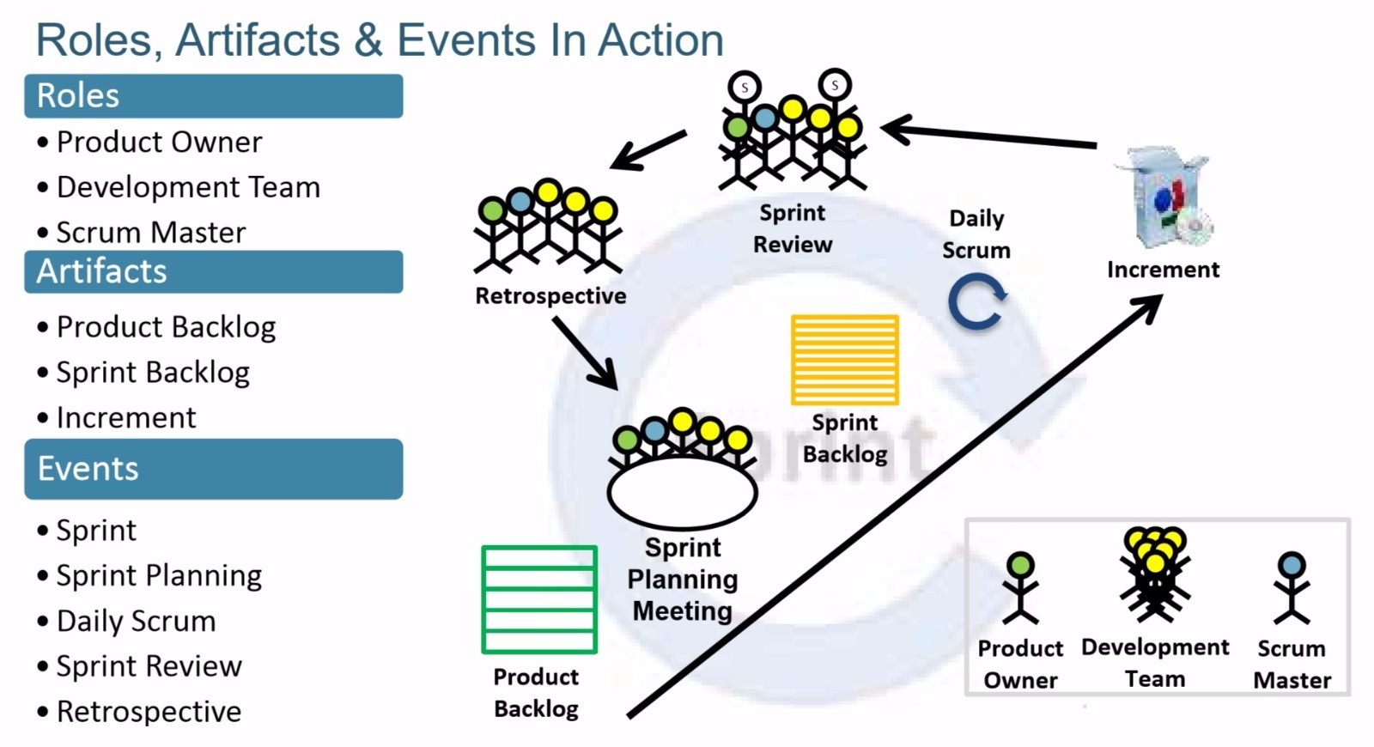
SCRUM Framework

Slide 13
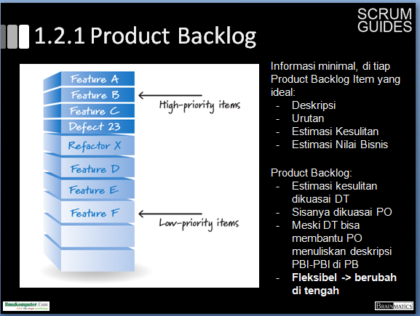

Slide 14
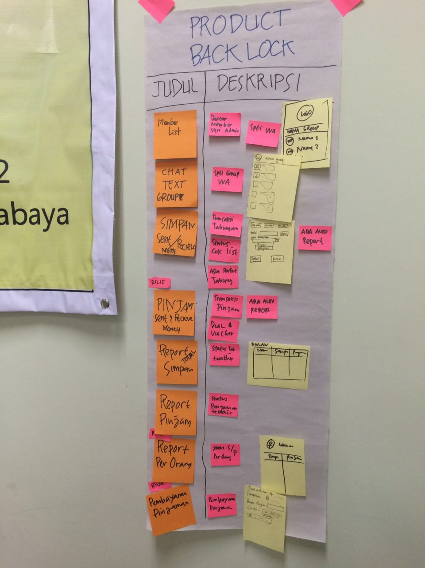
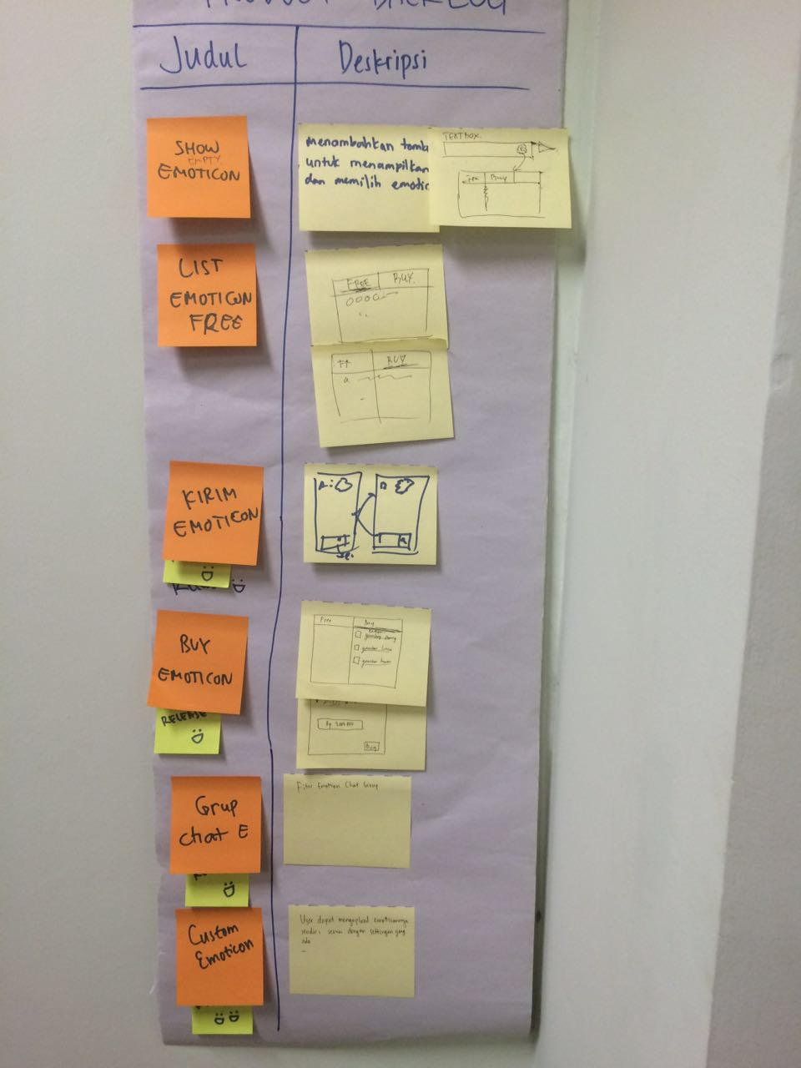
Product Backlog

Slide 15
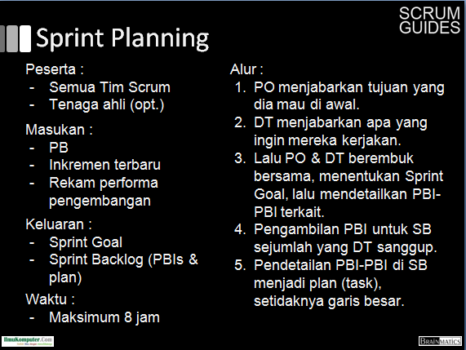
Sprint Planning

Slide 16
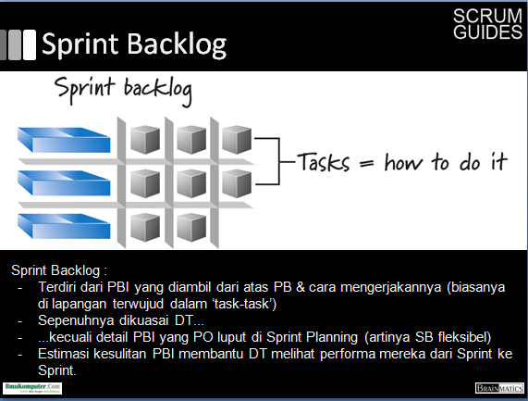

Slide 17
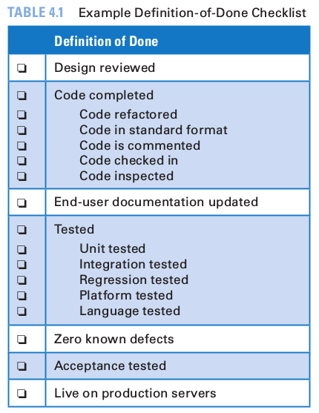
Definition of Done

Slide 18
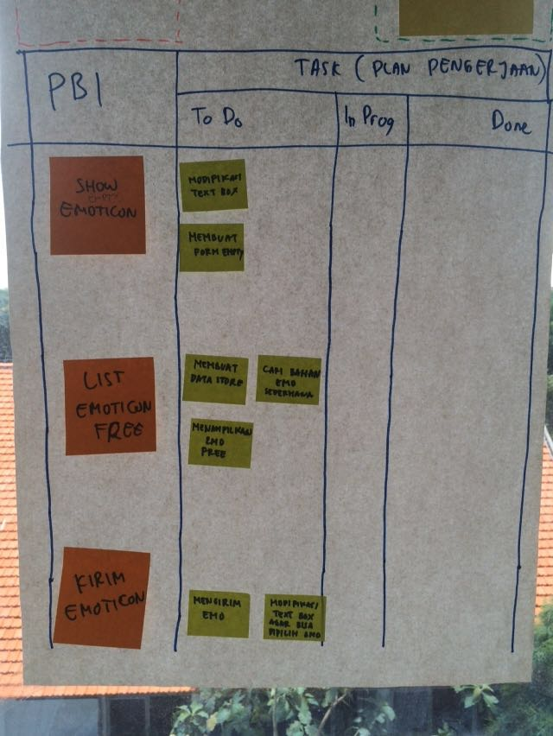
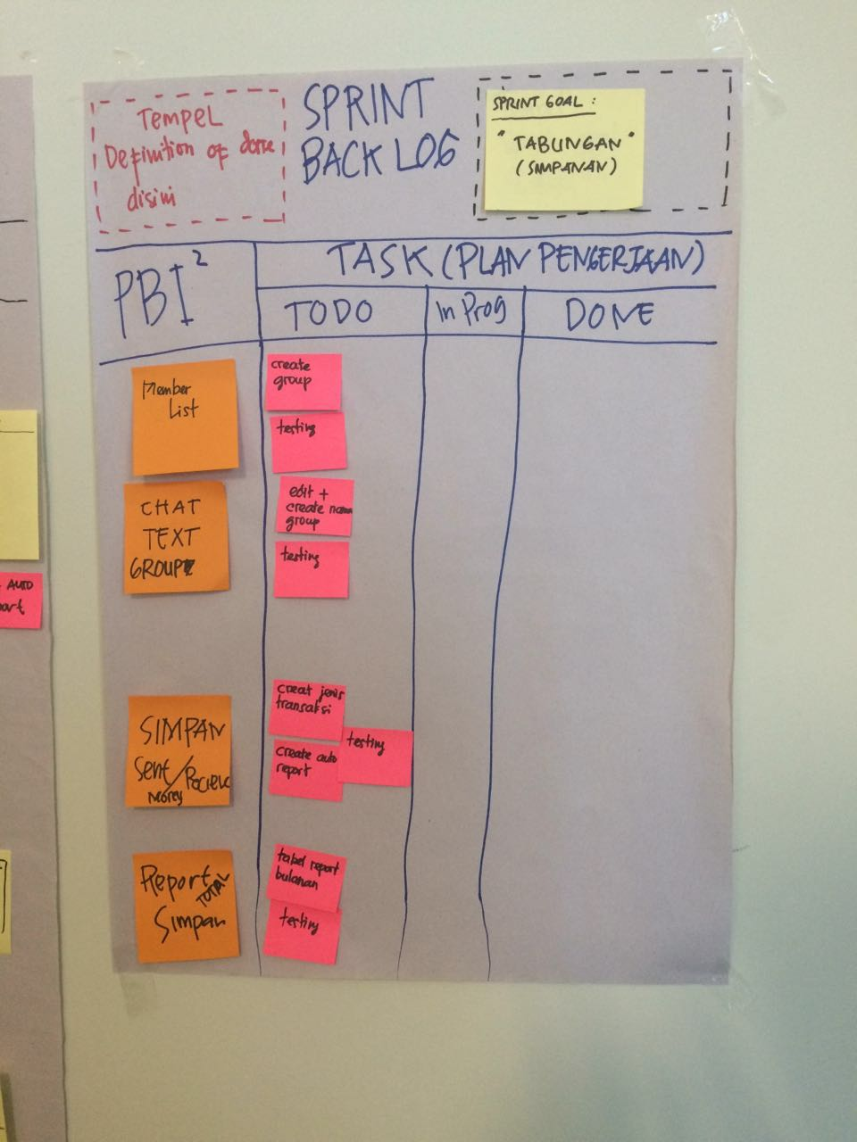
Sprint Backlog

Slide 19
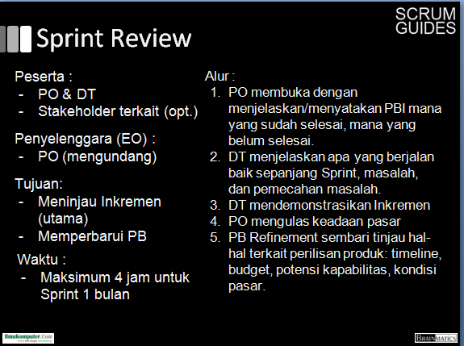

Slide 20
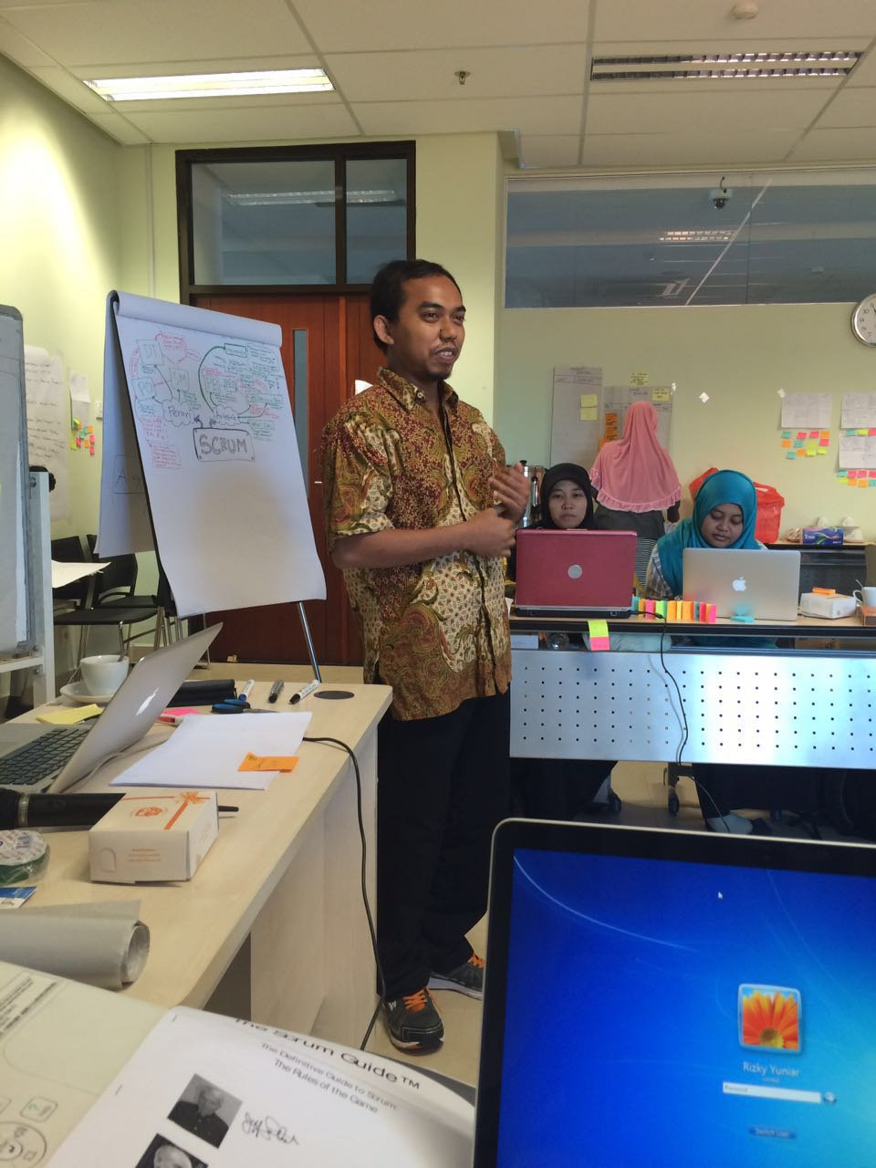
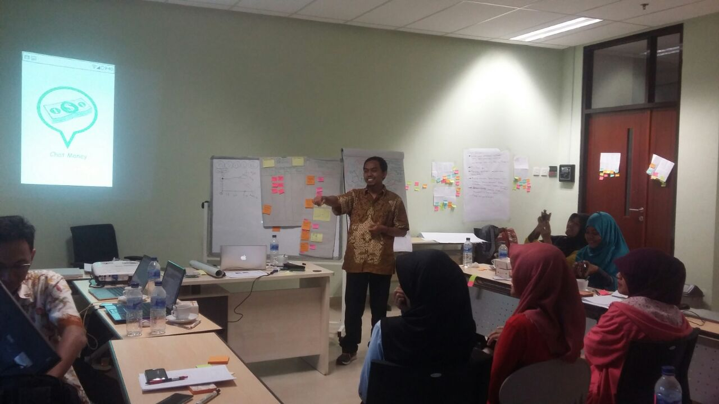
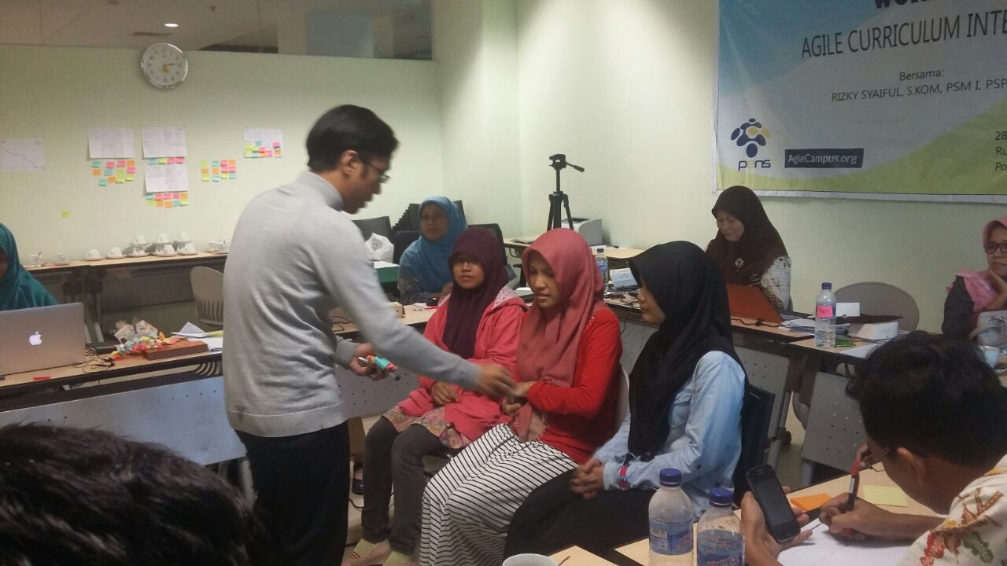
Sprint Review

Slide 21
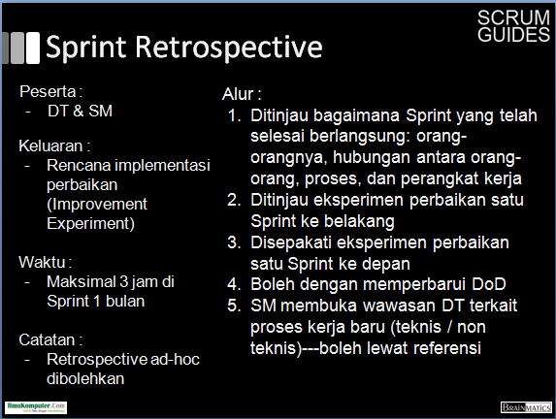
Sprint Retrospective

Slide 22
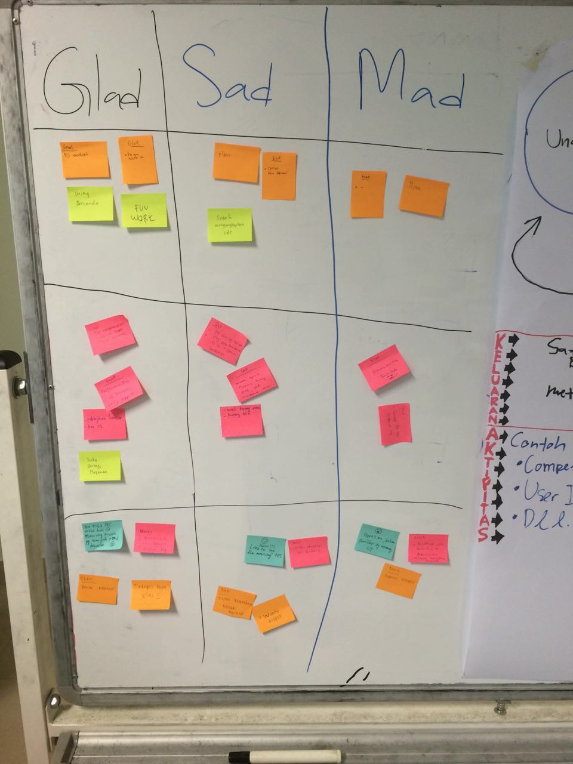
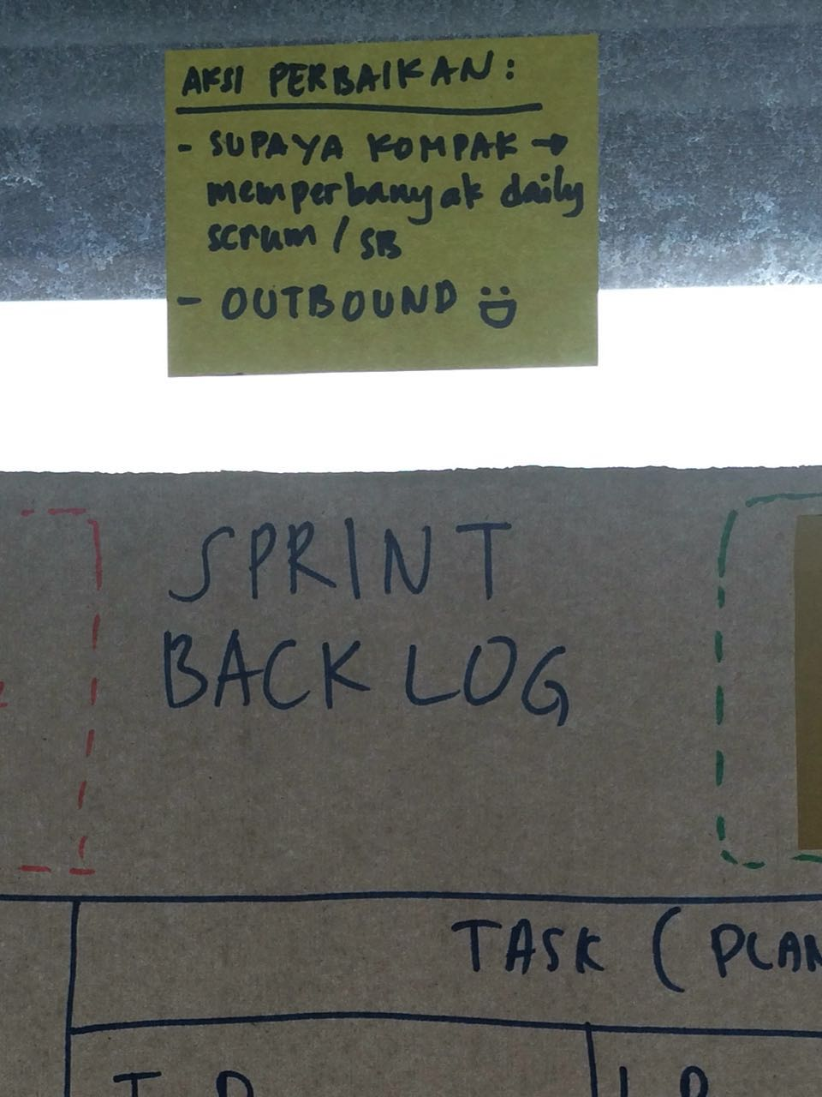
Sprint Retroscpective

